Slide 1
Dynamic light scattering
2011049
2011050
2011051
2011052
2011053
2011054
MME-308
Materials laboratory I

Slide 2
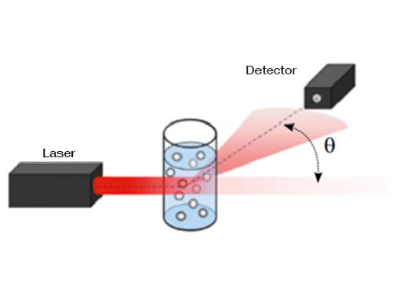
Introduction
Dynamic Light Scattering (DLS) is a powerful analytical technique used to measure the size and size distribution of particles, emulsions, or molecules in suspension, typically in the nanometer to micrometer range.

Slide 3
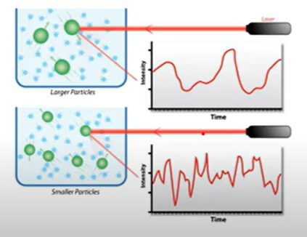
Key Concept:
What it does: DLS analyzes fluctuations in the intensity of light scattered by particles undergoing Brownian motion in a liquid.
How it works: By measuring these fluctuations and applying the Stokes-Einstein equation, it calculates the hydrodynamic diameter of the particles.

Slide 4
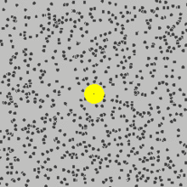
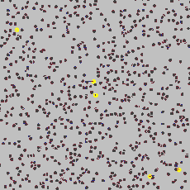
Brownian Motion
&
Hydrodynamic Size
It is the random movement of particles due to bombardment of by the solvent molecules that surround them
DLS measures the speed of particles undergoing Brownian motion
Small particles diffuse rapidly
Large particles diffuse slowly
The diameter of a hard sphere that diffuses at the same speed as the particle or molecule being measured is the hydrodynamic size

Slide 5
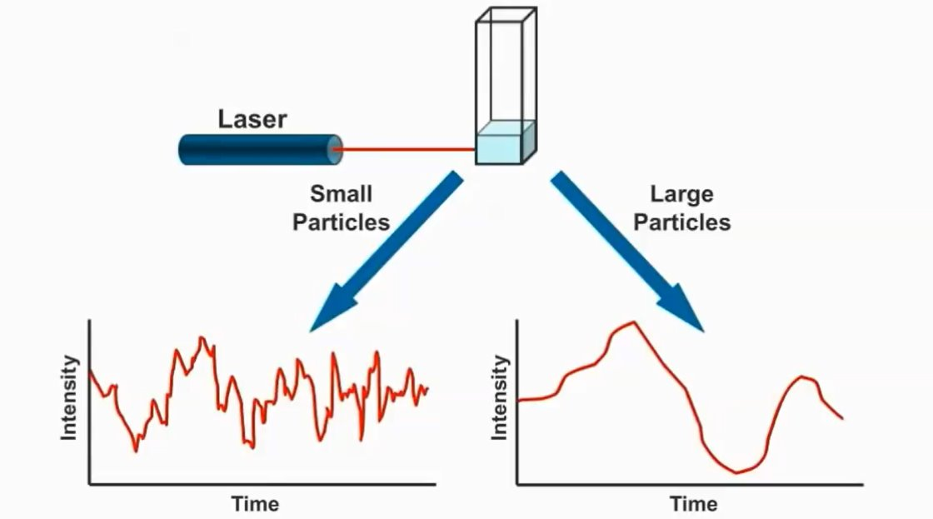
Mechanism
How Dynamic Light Scattering Works:
Laser Scattering
  A monochromatic laser beam illuminates the sample.
  Particles in suspension scatter the light in all directions.
Brownian Motion
  Particles undergo random motion due to thermal energy.
  Smaller particles move faster than larger particles.
Intensity Fluctuations
  The scattered light creates an interference pattern.
  This pattern fluctuates over time due to particle motion.

Slide 6
Data Collection and Analysis
Step 1: Autocorrelation Function
The intensity fluctuations are analyzed using a mathematical tool called the autocorrelation function.
This calculates how the intensity of scattered light at a given time relates to its intensity at a later time.
Step 2: Diffusion Coefficient
The decay rate of the autocorrelation function is proportional to the diffusion coefficient of the particles.
Faster decay = smaller particles.
Step 3: Hydrodynamic Diameter
Using the Stokes-Einstein Equation, the diffusion coefficient is converted into the hydrodynamic diameter, which includes the particle and its solvent layer.

Slide 7
Visual Representation
Include Visuals:
A diagram showing:
  Laser beam interacting with particles in suspension.
  Scattered light being collected by a detector.
A graph of the autocorrelation function showing decay over time.
A flowchart summarizing the steps:
  Intensity fluctuations → Autocorrelation function → Diffusion coefficient → Hydrodynamic diameter.

Slide 8
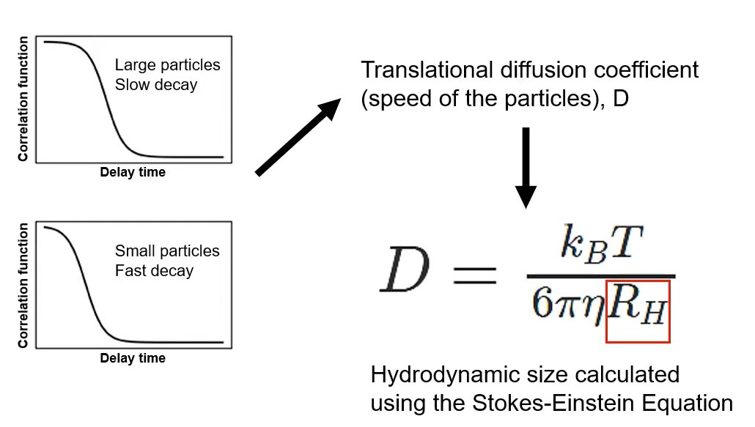
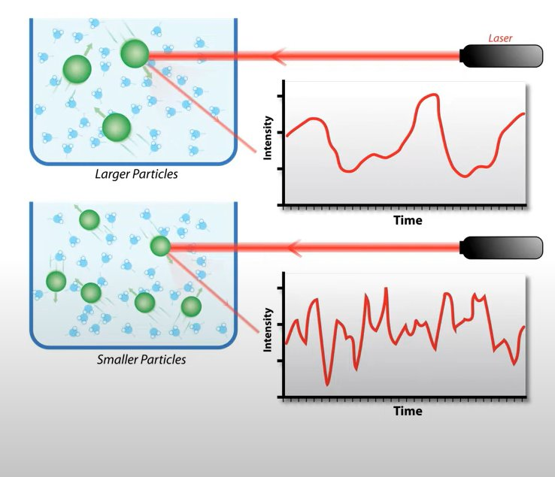

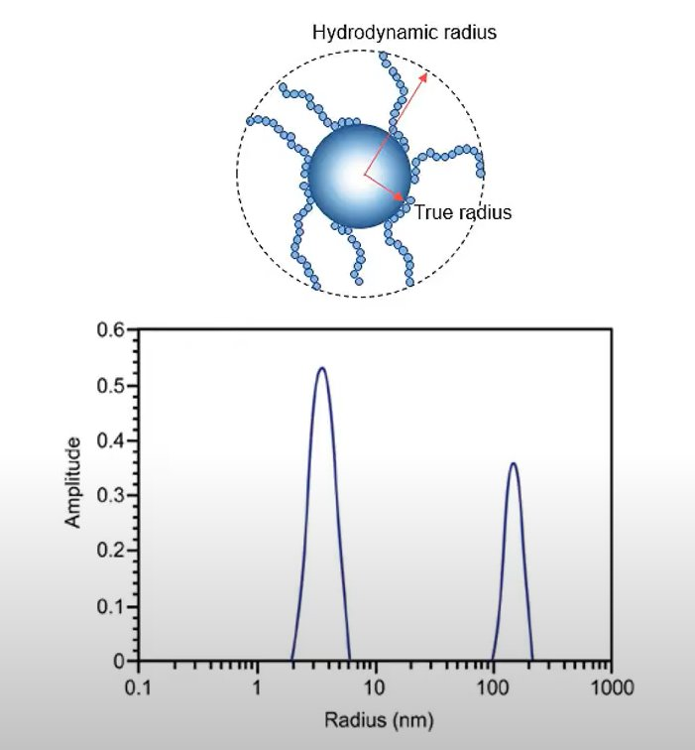

Slide 9

Stokes-Einstein Relation: Relating Particle Size to Particle Motion
Here:
Dh is the hydrodynamic diameter (this is the goal: particle size!)
Dt is the translational diffusion coefficient (we find this by dynamic light scattering)
kB is Boltzmann’s constant (we know this)
T is thermodynamic temperature (we control this)
η is dynamic viscosity (we know this)

Slide 10
Key Assumptions and Considerations
Key Assumptions:
Particles are spherical.
The medium is homogeneous.
Considerations:
Impurities or aggregates can affect the data.
DLS provides an average size, not detailed size distributions.

Slide 11
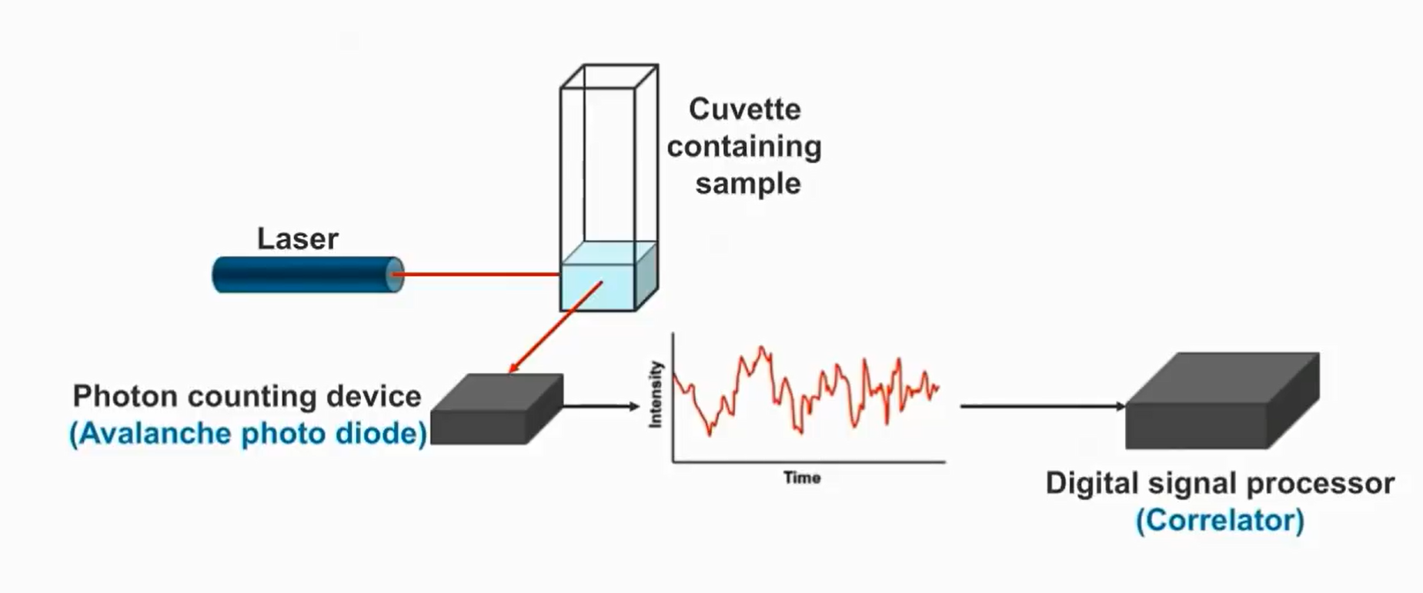
Key Components
Laser Source
Sample Cell
Detector
Correlator
Temperature Controller
Computer & Software

Slide 12
Key Parameters in DLS
Hydrodynamic Diameter
Diffusion Coefficient
Polydispersity Index (PDI)
Scattering Intensity
Zeta Potential
Correlation Function
Refractive Index
Wavelength

Slide 13
Factors Affecting DLS
Particle Concentration
Polydispersity
Sample Clarity
Sample Viscosity
Temperature
Refractive Index Mismatch
Ionic Strength and pH
Instrument Settings

Slide 14

Tips for Reliable DLS Measurements
Dilution: Avoids multiple scattering by adjusting sample concentration.
Filtration: Removes dust and aggregates for clear results.
Consistent Environment: Maintains stable temperature and reduces vibrations.
Calibration: Ensures accuracy with regular instrument checks.
Multiple Runs: Confirms reproducibility by averaging results.

Slide 15
Applications of DLS
Nanoparticle Characterization
Size determination and stability assessment in solution.
Biomolecular Analysis
Protein aggregation detection and nucleic acid size characterization.
Polymer Science
Molecular weight estimation and aggregation studies.
Colloidal Systems
Emulsion stability monitoring.
Environmental Monitoring
Particle size analysis in aerosols and sediments.
Food Science
Stability and ingredient characterization in food systems.
Drug Delivery
Nanocarrier characterization and drug release studies.

Slide 16
Advantages and Disadvantages
Advantages
Detects particles as small as 1 nm.
Measures hydrodynamic size in native conditions.
Fast, simple, and high-throughput.
Requires minimal, non-destructive sample volumes.
Tracks stability, aggregation, and growth.
Cost-effective and widely accessible.
Disadvantages
Struggles with polydisperse size distributions.
Inaccurate for non-spherical particles.
Provides indirect, intensity-weighted measurements.

Slide 17
Thank you

